Slide 1
Skeleton Recall Loss for Connectivity Conserving and Resource Efficient Segmentation of Thin Tubular Structures
ECCV, 2024
Yannick Kirchhof, Maximilian R. Rokuss, Saikat Roy, Balint Kovacs
German Cancer Research Center (DKFZ) Heidelberg, Division of Medical Image
Computing, Germany
Notes:
Good morning/afternoon everyone. Today, I’m going to introduce the work on Skeleton Recall Loss, a novel loss function designed for connectivity-preserving segmentation of thin structures.
Segmenting thin and curvilinear structures, such as blood vessels, cracks, and roads, is a critical challenge in medical imaging and engineering applications. Traditional segmentation methods often fail to maintain the topology of these structures, leading to broken or misconnected regions. The proposed loss function effectively addresses this issue while remaining efficient and architecture-agnostic.

Slide 2
Outline
Introduction
Related work
Method
Experiments
Conclusion
Notes:
This is the outline, I tear into 5 parts .
Let’s start to introduce the paper.

Slide 3
Outline
Introduction
Related work
Method
Experiments
Conclusion

Slide 4
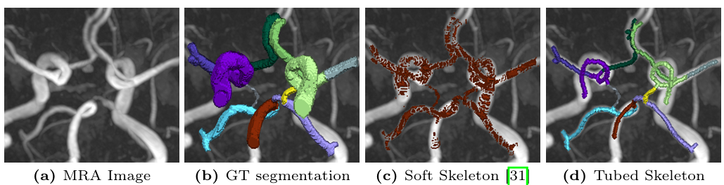
Introduction
Challenge
High Computational Cost : Many topology-aware segmentation methods, such as clDice Loss, require GPU-intensive skeletonization, increasing training time and memory usage.
Architecture Dependency : Some methods require modifications to the network architecture, limiting their flexibility.
Limited Multi-Class Support : Existing topology-aware losses struggle with multi-class segmentation due to excessive computational requirements.
Notes:
Thin structure segmentation is challenging because standard pixel-wise losses, such as Dice Loss or Cross-Entropy Loss, do not explicitly consider connectivity. Some recent methods, like clDice Loss, attempt to preserve connectivity using differentiable skeletonization, but they suffer from high computational costs and memory usage, especially in multi-class settings.
High Computational Cost – Many topology-aware segmentation methods, such as clDice Loss, require GPU-intensive skeletonization, increasing training time and memory usage.
計算成本高 – 許多拓撲保持的分割方法（如 clDice Loss）需要 GPU 密集的骨架化處理，導致訓練時間和記憶體需求增加。
Architecture Dependency – Some methods require modifications to the network architecture, limiting their flexibility.
架構依賴性 – 某些方法需要對網路架構進行修改，降低其通用性。
Limited Multi-Class Support – Existing topology-aware losses struggle with multi-class segmentation due to excessive computational requirements.
多分類支援受限 – 現有的拓撲保持損失函數在多類別分割時計算需求過高，難以適用。
Main Tasks (主要任務)
Efficient Training – Develop a loss function that maintains topology without significantly increasing training time or memory usage. 高效訓練 – 設計一種能夠保持拓撲結構但不顯著增加訓練時間與記憶體消耗的損失函數。
Architecture Independence – Ensure compatibility with various segmentation networks without requiring modifications. 架構獨立性 – 使其能夠無縫整合到不同的分割模型中，而無需修改網路架構。
Multi-Class Segmentation – Enable topology-preserving segmentation for both binary and multi-class tasks. 多分類分割 – 使拓撲保持分割適用於二元與多類別分割任務

Slide 5
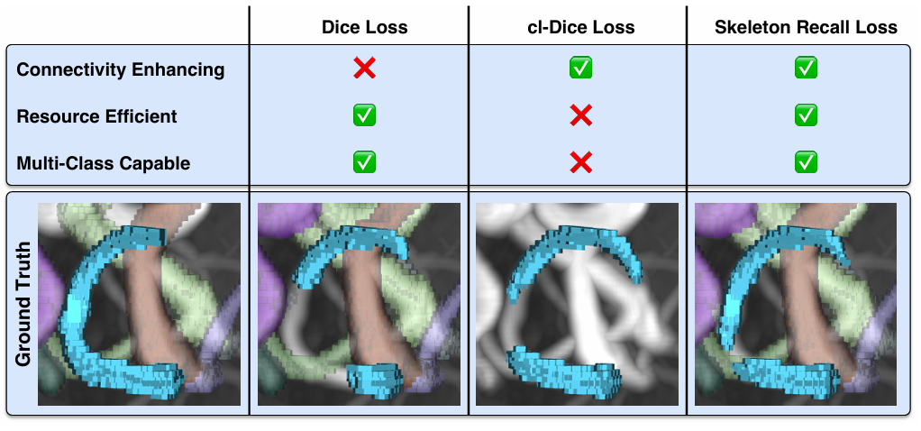
Introduction
Contributions
Efficient and Lightweight – Skeleton Recall Loss computes topology-aware segmentation with minimal training time and memory by leveraging CPU-based operations instead of GPU-intensive skeletonization.
Architecture-Agnostic – It seamlessly integrates with various 2D and 3D segmentation models without requiring architectural modifications.
Multi-Class Support – Unlike clDice Loss, it efficiently handles multi-class segmentation while maintaining connectivity with minimal computational cost.
Comparison of state-of-the-art loss functions on the task of thin structure segmentation.
Notes:
To overcome these limitations, the paper introduce Skeleton Recall Loss, which has the following advantages:
Minimal Computational Cost – Unlike clDice Loss, our method avoids GPU-intensive skeletonization, making it highly efficient.
Topology-Preserving – It explicitly optimizes for connectivity conservation, reducing errors in connected components (β₀) and loops (β₁).
Architecture-Agnostic – It can be integrated into different 2D and 3D segmentation models without modifications.
Multi-Class Compatibility – It supports multi-class segmentation with minimal additional overhead.
Efficient and Lightweight – Skeleton Recall Loss computes topology-aware segmentation with minimal training time and memory by leveraging CPU-based operations instead of GPU-intensive skeletonization.
高效且輕量 – Skeleton Recall Loss 利用 CPU 運算取代 GPU 密集骨架化處理，大幅減少訓練時間與記憶體消耗。
Architecture-Agnostic – It seamlessly integrates with various 2D and 3D segmentation models without requiring architectural modifications.
架構無關性 – 可無縫適配不同的 2D 和 3D 分割網路，無需修改架構。
Multi-Class Support – Unlike clDice Loss, it efficiently handles multi-class segmentation while maintaining connectivity with minimal computational cost.
多類別支援 – 相較於 clDice Loss，其可有效維持連通性並處理多類別分割，且計算成本極低。

Slide 6
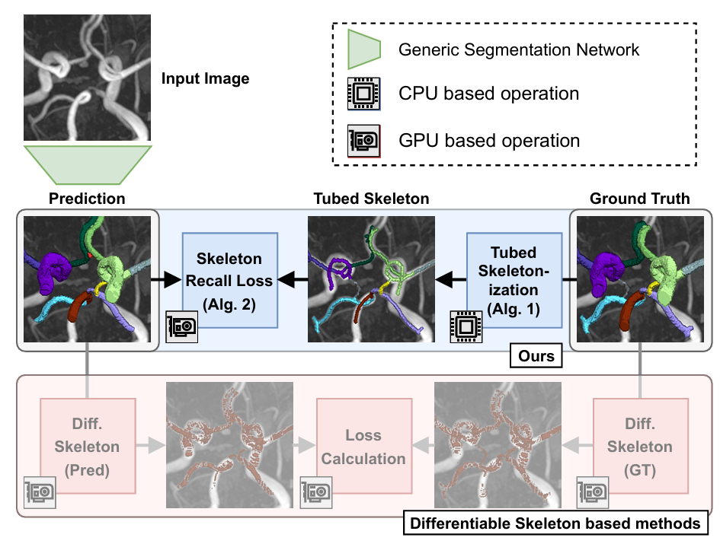
Introduction
Framework
Notes:
The framework consists of three key components: Segmentation Network –to use a baseline segmentation model such as nnUNet or HRNet to generate an initial prediction.
Tubed Skeleton Computation – Instead of using a computationally expensive differentiable skeletonization, it precompute a Tubed Skeleton from the ground truth using lightweight image processing techniques.
Skeleton Recall Loss – During training, it compare the predicted segmentation mask with the precomputed Tubed Skeleton to ensure connectivity preservation without excessive computational overhead.

Slide 7
Outline
Introduction
Related work
Method
Experiments
Conclusion

Slide 8
Related work
clDice- a Novel Topology-Preserving Loss Function for Tubular Structure Segmentation, IEEE, 2021
Centerline Boundary Dice Loss for Vascular Segmentation, miccai, 2024

Slide 9
Related work
clDice- a Novel Topology-Preserving Loss Function for Tubular Structure Segmentation, IEEE, 2021
Centerline Boundary Dice Loss for Vascular Segmentation, miccai, 2024

Slide 10
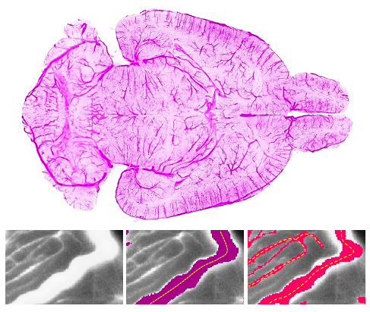
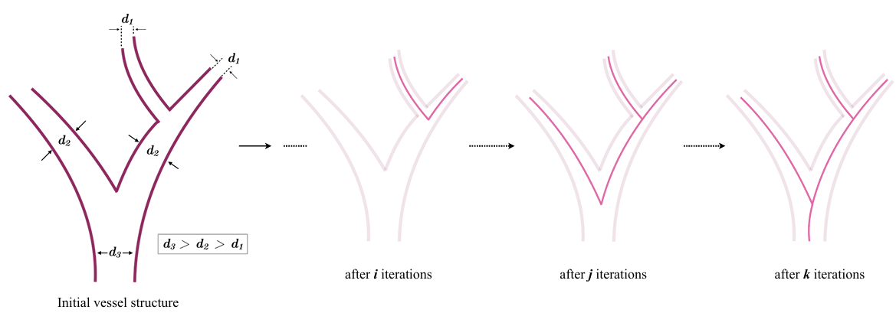
Related work
clDice
Problems
What is a good pixelwise measure to benchmark segmentation algorithms for tubular, and related linear and curvilinear structure segmentation while guaranteeing the preservation of the network-topology?
Can we use this improved measure as a loss function for neural networks, which is a void in existing literature?
Notes:
Q1. 有沒有一種好的像素級度量方法，可以在保證網絡拓撲保持的前提下，評估管狀、線狀和曲線結構的分割結果？
Q2. 我們能否將這種度量方法作為損失函數應用於神經網絡？（目前的文獻在這方面仍然存在空白）
左下角是介紹雖然粉色的主編框不好 但有找到小血管所以他比較好
右下角是skeleton的順序 蝶帶!

Slide 11
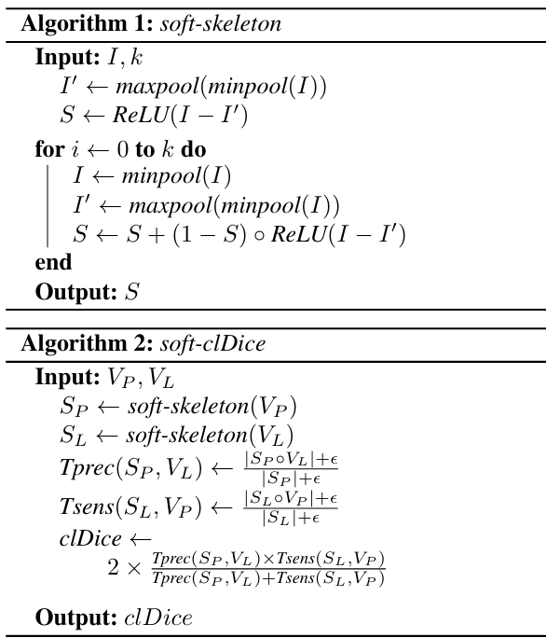
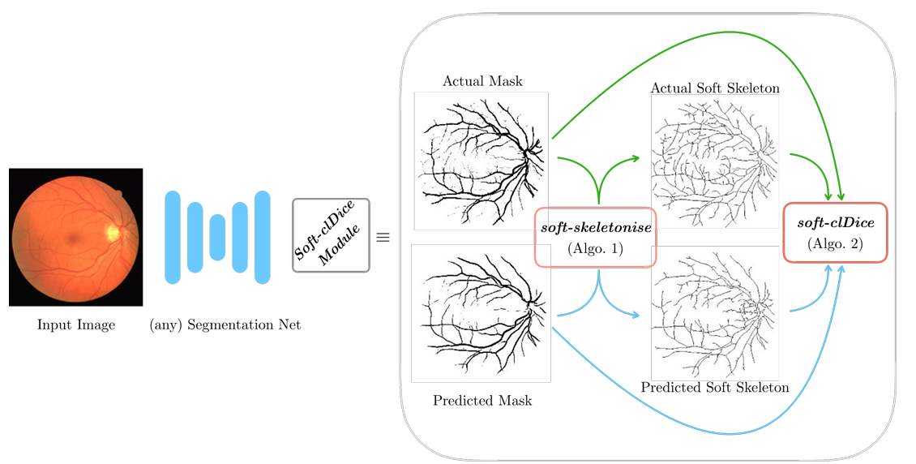
Related work
clDice
Overall framework

Slide 12
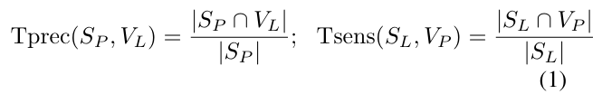


Related work
clDice
Notes:
Topology prediction易受False positive影響 (該出現的血管沒出現)
Topology sensitivity易受False negative影響 (不該出現的 卻出現ㄌ)\
希望同時最佳化精確/靈敏，所以cl定義為兩指標的調和平均數(harmonic mean)
另外因為希望是整個的拓樸結構而不是關注中心線，因此控制參數在0~0.5

Slide 13
Related work
clDice- a Novel Topology-Preserving Loss Function for Tubular Structure Segmentation, IEEE, 2021
Centerline Boundary Dice Loss for Vascular Segmentation, miccai, 2024

Slide 14
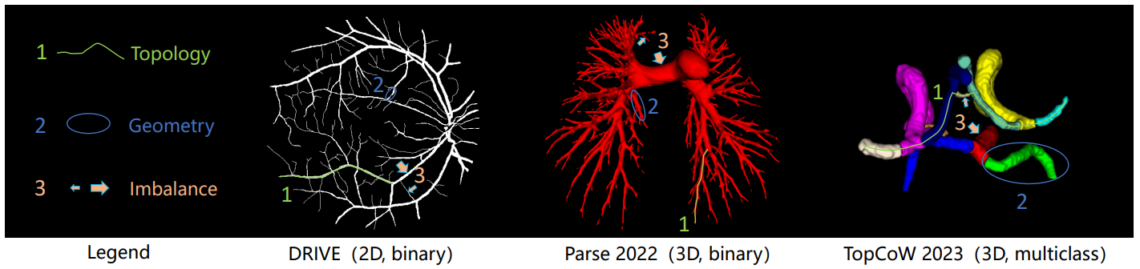
Related work
cbDice
Challenge
preserving the topology of the vascular network to enable accurate hemodynamic analysis
capturing the intricate geometric morphologies vital for the diagnosis of conditions like stenosis
attaining balanced segmentation across vessel diameters and consistent width adjustments within each branch to mitigate diameter imbalance
Notes:
1.保持血管網絡的拓撲結構，以便進行準確的血流動力學分析；
2.準確捕捉複雜的幾何形態，對於診斷狹窄等病變至關重要；
3.確保血管直徑的平衡分割，維持各分支內部的寬度一致性，以減少直徑不平衡的影響。

Slide 15
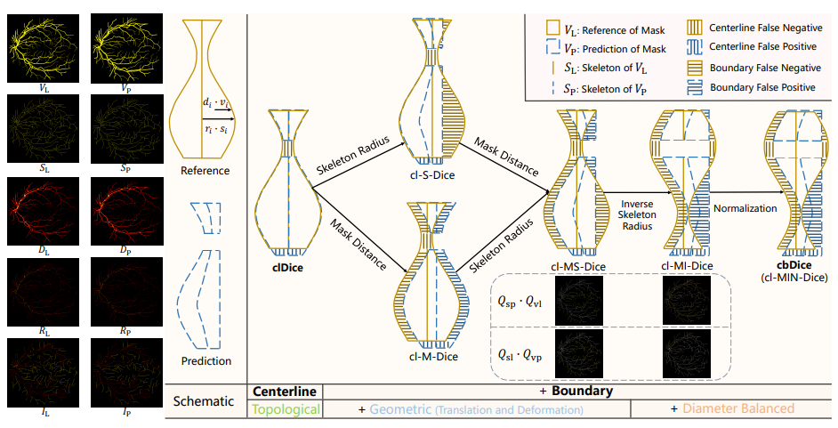
Related work
cbDice
Overall framework

Slide 16
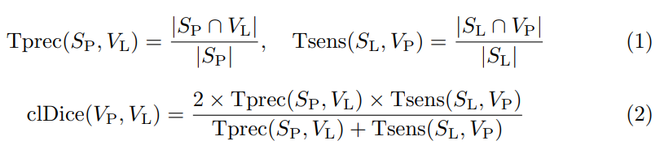
Related work
cbDice
Preliminary
The mask V
The corresponding skeleton S, derived from V
clDice

Slide 17



Related work
cbDice
D signifies the minimum distances from q mask points in V to their respective boundaries:
R associated with skeletal points in S:
I denotes the set of inverse skeleton radius for the same n skeletal points in S
normalized ratios are represented as
Notes:
D是距離映射(到邊界的最小距離)
R是骨架半徑
I是倒數骨架半徑(目的是減少大血管的影響)
正規畫是為了可應用於不同Dataset

Slide 18
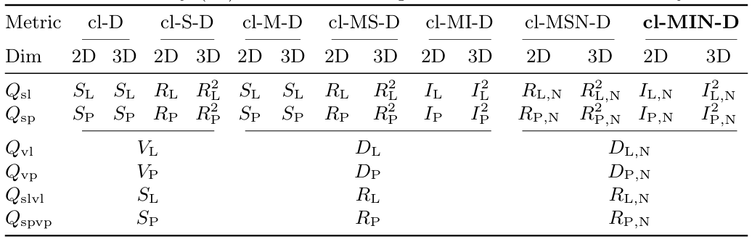
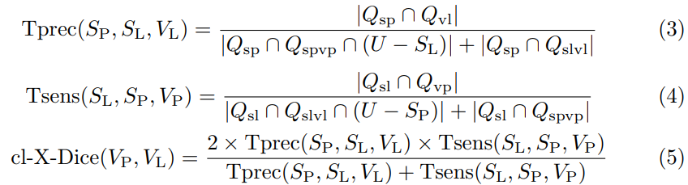
Related work
cbDice
Key notations for Q are defined as:
Notes:
reference (L), prediction (P), centerline (cl), Dice (D), skeleton (S), mask (M), inverse skeleton radius (I), normalized (N), and centerline boundary (cb).
cl-MIN-D is equivalent to cb-D in this study.
D、R是最小距離/骨架半徑的集合

Slide 19
Method
Introduction
Related work
Method
Experiments
Conclusion

Slide 20
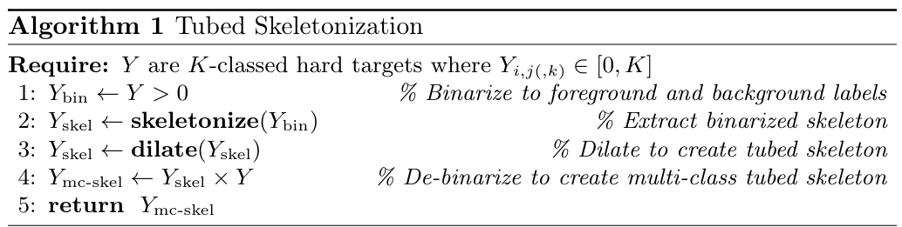
Method
Skeleton Recall Loss
Notes:
描述了 Tubed Skeletonization（管狀骨架化） 的過程，將多類別的分割標註圖轉換為骨架化版本，並保持類別資訊
1.二質化:
將多類別分割標註 Y 轉換為二值化標註 (Ybin)，前景設為 1，背景為 0
2.骨架化 :
對 Ybin 應用骨架化算法，提取前景區域的中心線，使結構變為細長的骨架
3.膨脹（生成管狀骨架):
對骨架進行膨脹處理，使其略微擴展，形成具有一定寬度的 Tubed Skeleton，而不是單像素的細線。
4.多類別骨架映射 :
將 Tubed Skeleton 與原始多類別標註圖 Y 相乘，使骨架保留正確的類別資訊。
5.輸出管狀骨架 :
最終輸出是一個 保持類別標籤的 Tubed Skeleton，可用於訓練分割模型，提高細長結構的連通性表現。

Slide 21
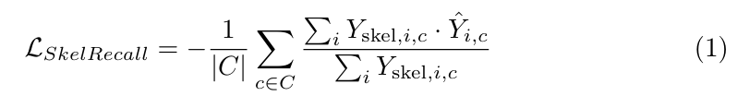
Method
Soft Recall on Tubed Skeleton
incentivize the network to include as much of this skeleton as possible as part of the prediction.
Notes:
使用 Skeleton Recall Loss 比較預測分割與 Tubed Skeleton，加強對於結構connectivity的學習。
盡可能完整且包含骨架

Slide 22
Outline
Introduction
Related work
Method
Experiments
Conclusion

Slide 23
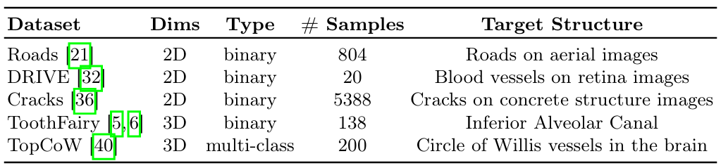
Experiments
Datasets
Roads
DRIVE
Cracks
ToothFairy
TopCoW
Evaluation Metrics
clDice (↑)
Dice(↑)
Betti Number Errors(↓)
Notes:
a) 衛星影像中的道路 b) 視網膜血管 c) 混凝土結構中的裂縫 d) 面部 CT 中的下齒槽管 e) 威利氏環（Circle of Willis）動脈血管組成部分
clDice 雖然在深度學習訓練中是一個低效的損失函數，但它卻是一個優秀的連通性評估指標
將 clDice 作為評估指標，並與 Dice 相似係數（Dice Similarity Coefficient） 一同用於評估重疊性與連通性。
Betti 數可以用來評估模型預測結果是否保留了目標結構的拓撲特性，例如血管的連通性或環狀結構的完整性。
β₀ 數量過多，表示它錯誤地將一個連續的結構分割成了多個部分（例如，應該相連的血管被斷開）。
β₁ 數量過多，表示它錯誤地產生了額外的環狀結構（例如，血管本來是直的，但模型預測出了一個額外的環）。

Slide 24
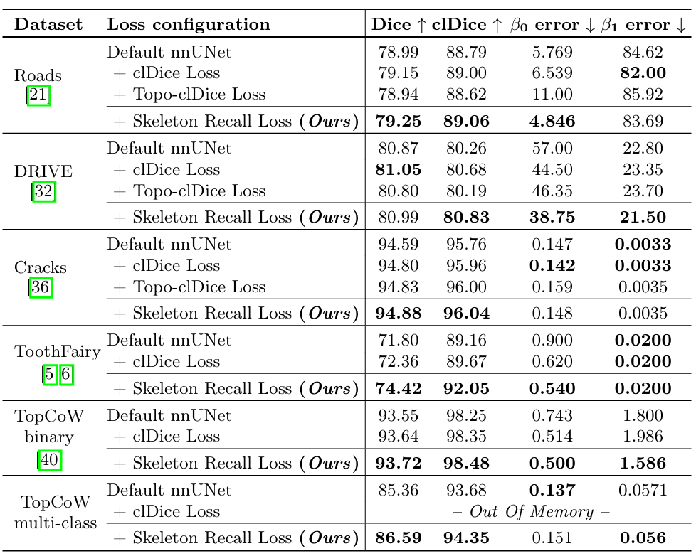
Experiments
Comparison with the state-of-the-art models
Notes:
Skeleton Recall Loss 在不同的細長結構數據集上（如 TopCoW、DRIVE、Cracks 等）都能夠有效提升 Betti 數的準確度，表示它能夠減少 連通成分和 環狀結構的錯誤。
clDice Loss [31]：目前該領域的主流方法，使用近似可微骨架來保留結構連通性。
Topo-clDice Loss：clDice Loss 的變體，該方法能生成拓撲準確的可微骨架，但計算資源消耗更大。

Slide 25
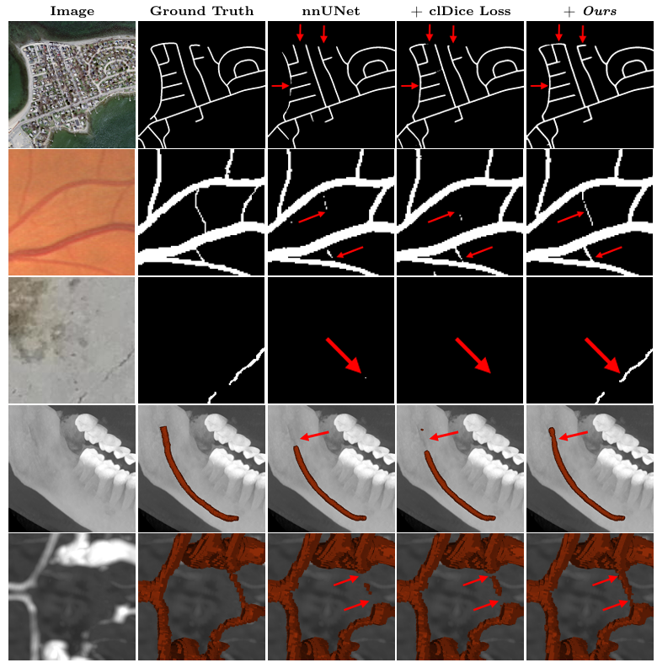
Experiments
Connectivity conservation in qualitative results on 5 datasets
Notes:
傳統的 Dice Loss 和交叉熵等標準損失函數雖然能夠分割出大部分結構，但在細長結構（如道路、血管、裂縫）上容易斷裂，導致連通性不佳。而 Skeleton Recall Loss 能更好地保持結構的完整性，使得分割結果的拓撲關係更貼近真實標註。

Slide 26
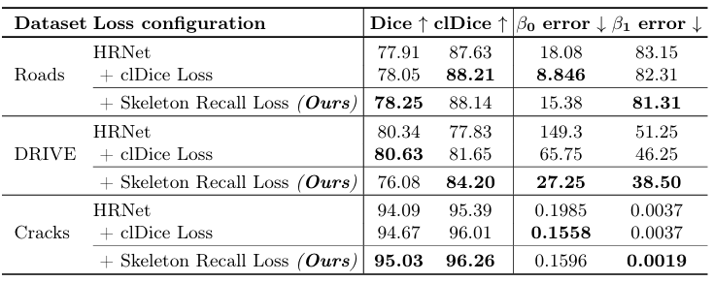
Experiments
Skeleton Recall Loss is architecture agnostic.
Notes:
Skeleton Recall Loss 不依賴特定的神經網絡架構，在 nnUNet 和 HRNet 等不同的 2D、3D 分割模型上均能帶來一致的提升，顯示出良好的可擴展性與泛化能力。
nnUNet [12]：針對醫學影像分割的強大網路。
HRNet [35]：目前最先進的自然影像分割網路，預訓練於 ImageNet

Slide 27
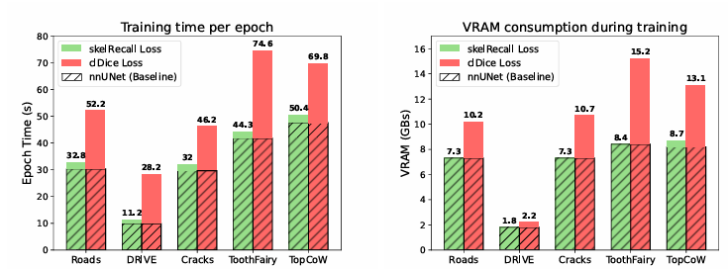
Experiments
Efficient Resource Utilization for Binary Segmentation.
Notes:
在 資源消耗分析中，Skeleton Recall Loss 相較於 clDice Loss 幾乎不會增加額外的計算成本。它透過 預計算骨架（Tubed Skeleton），避免了在 GPU 訓練時進行昂貴的骨架化計算，使得訓練時間和 GPU 記憶體消耗都與標準的 nnUNet 接近。

Slide 28
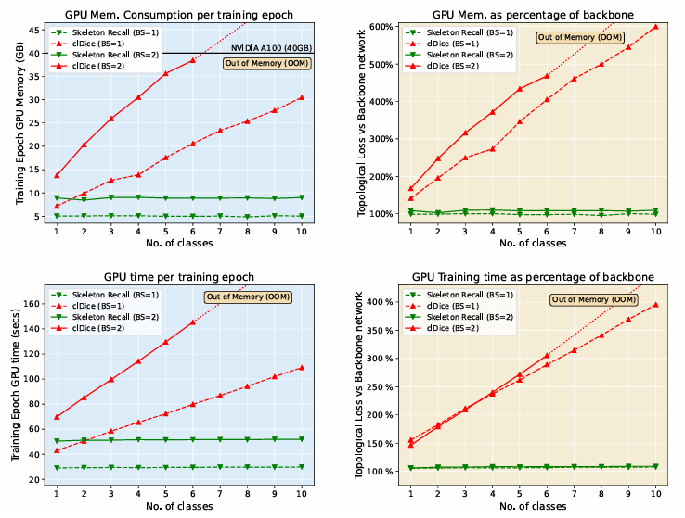
Experiments
Resource Utilization for Multi-class Segmentation
Notes:
在 資源消耗分析中，Skeleton Recall Loss 相較於 clDice Loss 幾乎不會增加額外的計算成本。它透過 預計算骨架（Tubed Skeleton），避免了在 GPU 訓練時進行昂貴的骨架化計算，使得訓練時間和 GPU 記憶體消耗都與標準的 nnUNet 接近。

Slide 29
Outline
Introduction
Related work
Method
Experiments
Conclusion

Slide 30
Conclusion
Demonstrating that Skeleton Recall Loss shows overall superior performance on existing state-of-the-art topology-aware loss functions through extensive evaluation on five publicly available datasets
Skeleton Recall Loss represents a significant advancement in the field of thin structure segmentation, offering both efficiency and efficacy.
Notes:
1.通過對五個公開可用的數據集的廣泛評估，我們證明 Skeleton Recall Loss 在現有的最先進的拓撲感知損失函數上表現出整體優越的性能。
2.骨架召回損失代表了薄結構分割領域的重要優勢，兼具效率和功效
實驗結果證明，Skeleton Recall Loss 能夠 有效提升細長結構的分割質量，保持拓撲結構的完整性，同時具備較低的計算成本，且適用於多類別與不同架構的分割任務。這使得它成為一個高效、靈活且易於部署的損失函數，在工程與醫學影像的細長結構分割任務中具有重要價值。

Slide 31
THE END

